Slide 1

2011 ICG Intern Training UNIX Introduction
Li Wei wei3.li@citi.com
Jul 2011
Notes:
DO
SAY
SHOW OVERHEAD.
Welcome to Management Development module 2 on providing feedback, coaching, and motivation.
This module builds on our earlier session on transitioning to management, interviewing, and team building.

Slide 2
UNIX Introduction - Topics
Session I
UNIX Overview
Xwindow System
Get help in UNIX
Directory Structure
Shell Introduction
Basic UNIX commands (Part I)
Readline Introduction
Job control in Shell
Viewer and Editor
Session II
Mode/Permission Introduction
Package manager
Get System Info
Quote in UNIX Shell
Regular expression
Basic UNIX commands (Part II)
Schedule job via Crontab/at
Version control

Slide 3
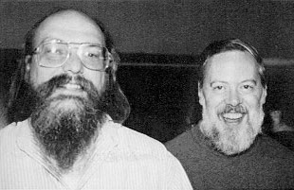
UNIX Introduction – Overview
History
1969 A&T, by Ken Thompson & Dennis Ritchie
1973 recoded by C Language
Added pipe support
Douglas McIlroy (diff, sort, join, tr etc.)
1977 BSD
1991 Linux
UNIX systems
BSD, Solaris, AIS, HP-UX, XENIX
BSD and TCP/IP
Linux, Minix, android
Darwin, OSX, iOS
Cygwin, mks
UNIX philosophy
KISS - Keep it simple, stupid
Everything is a file.
Small program, single purpose.
Work together to solve complex problem.
Regular expression
Notes:
Ken, Space Travel game

Slide 4
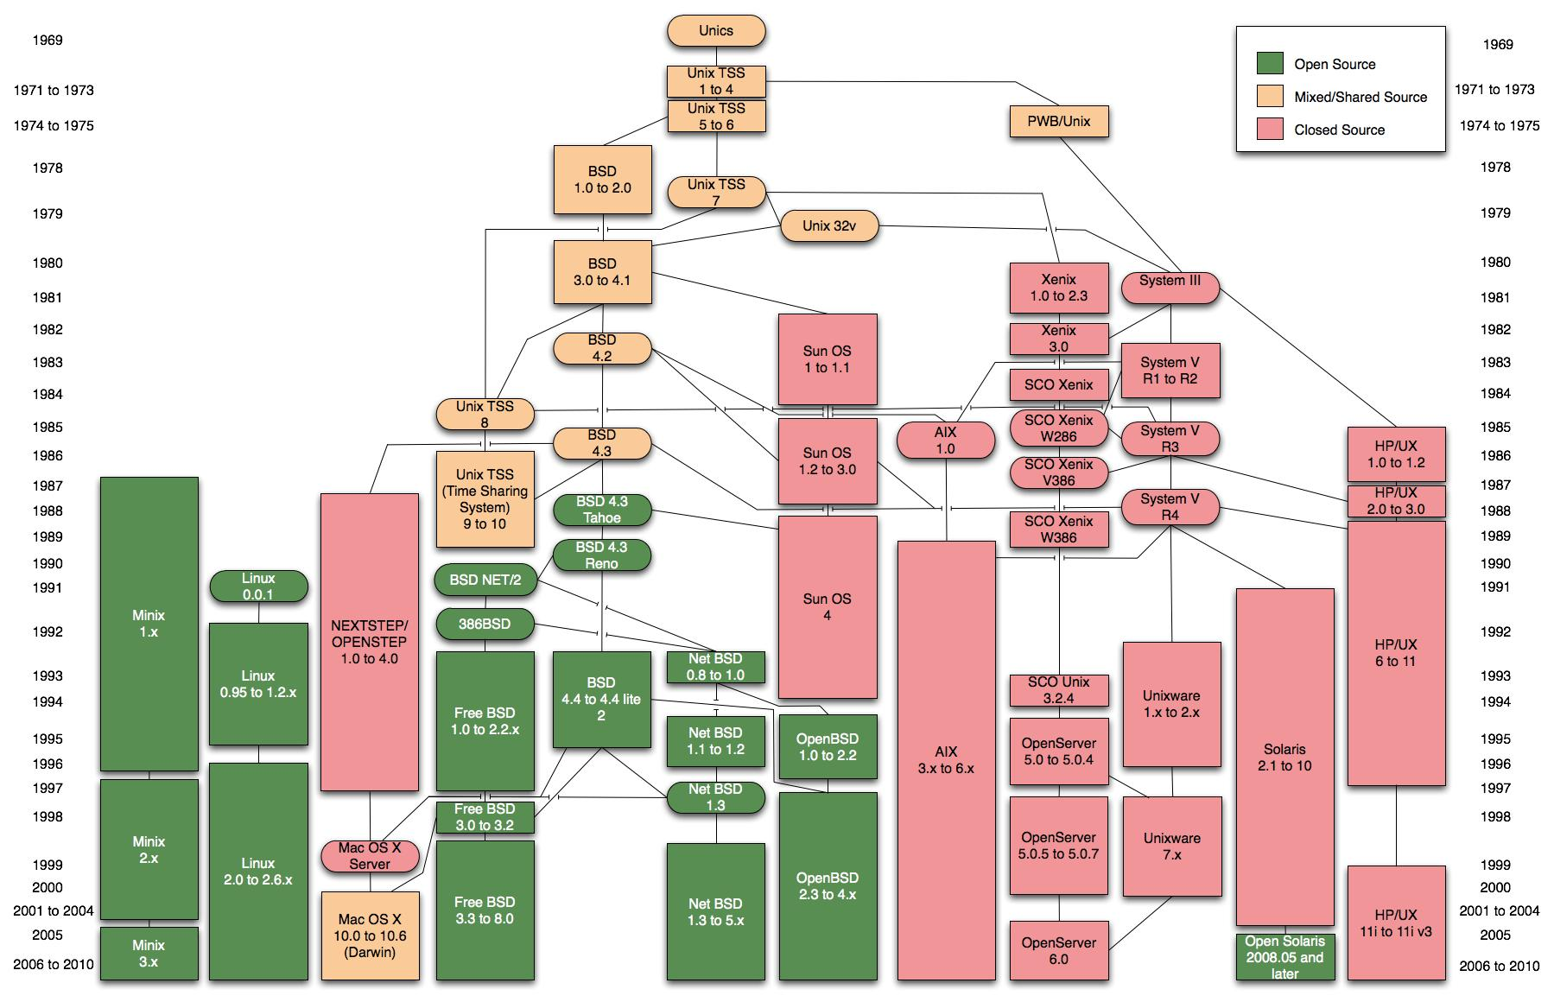
UNIX Introduction – Overview

Slide 5
UNIX Introduction – Xwindow
X History
1984 by MIT
based on network
1987 X11
X window version 11
X server
X11, Xorg
Exceed, XWin32, Cygwin X11
DISPLAY
:0.0
APACCNSHZJW1509:0.0
192.168.0.1:1.0
Security
Xhost
Xauth
xhost +hkdevedt6 : allow hkdevedt6 to access
xhost + : allow all host to access
xhost – : disallow any host to access
export ISPLAY=APACCNSHZJW1509:2.0
xauth generate $DISPLAY
xauth extract - $DISPLAY | ssh hkdevedt6 xauth merge -

Slide 6
UNIX Introduction – help system
Man section | description
1 | user command
2 | sys call
3 | library
4 | device driver
5 | file format
6 | game
7 | others
8 | sys admin
9 | kernel
man
find and display reference manual pages
Man page sections
man –s1 printf
man –s3 printf
man –M /usr/man ls
Man page environment var
MANPATH= /home/wl42485/tools/man:/usr/man:/usr/local/man
PAGER=less
apropos
locate commands by part of keyword. Same as man –k keyword
whatis
display a one-line summary about a keyword. Same as man –f keyword
[wl42485@hkdevedt6]$ apropos ereis
whereis whereis (1b) - locate the binary, source, and manual page files for a command
[wl42485@hkdevedt6]$ whatis vi
vi vi (1) - screen-oriented (visual) display editor based on ex

Slide 7
UNIX Introduction – help system
whereis (linux)
locate the binary, source, and manual page files for a command
which
locate a command; display its pathname or alias. Like whereis
info (Linux)
Information help
INFOPATH=/usr/share/info:/home/wl42485/tools/share/info
file
determine file type
Google
Still not find a command? Write one yourself.
bash-2.03$ whereis vi
vi: /usr/bin/vi /usr/ucb/vi
[wl42485@hkalgo1d]$ which ls
/bin/ls
[[wl42485@hkdevedt6]$ file /bin/ls
/bin/ls: ELF 32-bit MSB executable SPARC Version 1, dynamically linked, stripped

Slide 8
UNIX Introduction – Login & Logout
Login
SSH
Tectia SSH
Open SSH
Putty
telnet/rsh (deprecated)
Home directory
$HOME ~ (sh does not use ~)
Logout
exit
can use C-d (press control + D)
Can set env variable IGNOREEOF to ignore certain time of C-d
How to setup env variable:
In csh, tcsh:
setenv VARNAME VARVALUE
In sh, bash, ksh:
VARNAME=VARVALUE
[wl42485@hkdevedt6]$ export IGNOREEOF=1

Slide 9
UNIX Introduction – Directory Structure
Path
separated by ‘/’. e.g. /usr/bin
Directory Structure
Directory | Description
dev | device file dir
etc | config file dir
bin | usr command dir
sbin | admin command dir
usr | user application, lib dir
var | dynamic data
tmp | temp dir
opt | option application dir
home | home dir
proc | Proc file system

Slide 10
UNIX Introduction – Directory Structure - proc
/proc file system (below is for linux)
It’s virtual file system, initialized when system is up.
we can check system or process information in /proc
Check info
Change value
Use /sbin/sysctl
Use echo
Path | Description
/proc/self | current process
/proc/net/arp | arp address table
/proc/net/dev | network devices
/proc/sys/kernel/shmmni | Mini share memory
/proc/sys/kernel/shmmax | Max share memory
/proc/sys/kernel/shmall | All share memory
/proc/cpuinfo | cpu information
/proc/mdstat | raid status
/proc/meminfo | Memory information
/proc/mounts | mount command
/proc/swaps | Swap information
/proc/version | Like uname -a
/proc/<PID> | cmdline
[wl42485@hkalgo1d]$ cat /proc/swaps
Filename Type Size Used Priority
/dev/cciss/c0d0p2 partition 16779884 224 -1
[wl42485@hkalgo1d]$ sysctl -w sys.kernel.shmmni=4096
[wl42485@hkalgo1d]$ echo 4096 > /proc/sys/kernel/shmmin

Slide 11
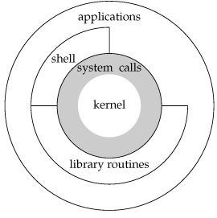
UNIX Introduction – Shell
Shell is user interface to communicate
with kernel
Login shell
In /etc/passwd
In NIS or LDAP
Shells
csh, tcsh
sh, jsh, bash
ksh, rksh
zsh
[wl42485@hkdevedt6]$ cat /etc/passwd | egrep root
root:x:0:1:Super-User:/:/sbin/sh

Slide 12
UNIX Introduction – Shell – init for shell
csh
/etc/.login
$HOME/.cshrc
$HOME/.login
$HOME/.logout
tcsh
/etc/tcshrc
$HOME/.tcshrc or $HOME/.cshrc
Sh
/etc/profile
$HOME/.profile
bash
/etc/profile
~/.bash_profile
~/.bash_login
~/.profile
$HOME/.bash_logout
ksh
/etc/profile
$HOME/.profile
$ENV
Note:
Only source $HOME/.cshrc for interactive csh
Note:
Only source $HOME/.bashrc for interactive bash
Note:
Only source $HOME/.tcshrc for interactive tcsh
Note:
Only source $ENV for interactive ksh

Slide 13
UNIX Introduction – Shell – Command line
use ";" to separate multiple cmd
use () to group cmd
use && || for condition check
&& run second cmd if the first cmd success (exit 0)
|| run second cmd if first cmd failed
use \ to input multiple line
Pipe (|)
[wl42485@hkdevedt6]$ cd /usr/bin; pwd; date
/usr/bin
Wed Jul 20 14:55:56 HKT 2011
[wl42485@hkdevedt6]$ (/bin/cal ; /bin/date) | mailx -s "test mail" wl42485
[wl42485@hkdevedt6]$ make && mailx –s “build completed” wl42485
[wl42485@hkdevedt6]$ (/bin/cal ; /bin/date) \
> | mail \
> -s "test mail" wl42485

Slide 14
UNIX Introduction – Shell – Command line
[wl42485@hkdevedt6]$ cat <<E
> a
> b
> E
a
b
Here Document
a way to read from stdin
<<word
No space/tab allowd before word
<<-word
Can add tab before word to format text. (Note: cannot be a space)
STDIO
0 stdin
1 stdout
2 stderr
IO redirect
> redirect stdout to a file
< read from a file
>> append stdout to a file
IO direct is different between shells
Description | Sh | csh
redirect output | 2>file1 1>file2 | >& file
redirect error | 2> file | (cmd > /dev/null) >& file

Slide 15
UNIX Introduction – Shell – Sub shell and current shell
Run command in sub shell, it will not change current shell
`cmd` or $(cmd)
use output of cmd as another command to run
(cmd), group commands
Run command in current shell. It will affect current shell
source (.)
eval
[wl42485@hkdevedt6]$ echo date
date
[wl42485@hkdevedt6]$ `echo date`
Wed Jul 20 15:34:07 HKT 2011
[wl42485@hkdevedt6]$ pwd
/home/wl42485
[wl42485@hkdevedt6]$ (cd /; pwd) ; pwd
/
/home/wl42485
[wl42485@hkdevedt6]$ eval "cd /usr"
[wl42485@hkdevedt6]$ pwd
/usr

Slide 16
UNIX Introduction – Shell – Customize your env
Environment variable
Shell prompt
For bash:
for csh: set prompt="$LOGNAME@$HOSTNAME $"
PROMPT_COMMAND: run command before prompt display (for bash)
Like below, it will set terminal title to include login name, host and current path
PATH : search path of commands. Paths are Separated by “:”
CDPATH : search path for cd
LD_LIBRARY_PATH: runtime library path
MANPATH: manual path
INFOPATH: info path
Export environment variable to let them visible in sub shell
PS1 | primary prompt of shell. E.g. PS1='$PWD[\u@\h]$'
PS2 | prompt for multiline cmd
PS3 | prompt for select
PS4 | prompt for verbose mode prefix
PROMPT_COMMAND='echo -n "^[]0;$LOGNAME@$HOSTNAME $PWD^G"‘ #C-v ESC to input ^[
PATH=/bin:/usr/bin:~/bin
export PATH

Slide 17
UNIX Introduction – Shell – Customize your env
shopt (man bash)
shopt is a build in cmd in bash
Set option: shopt –s option
Disable option: shopt –u option
shopt -s cdspell : to ignore minor typo in cmd line.
shopt –s lithist: enable multi-line mode for cmd history instead of only one line
[wl42485@hkdevedt6]$ ls
test/
[wl42485@hkdevedt6]$ cd tesa
test
[wl42485@hkdevedt6]$ pwd
/home/wl42485/temp/test
[wl42485@hkdevedt6]$ for i in a b c ; do
echo $i
done
a
b
c
[wl42485@hkdevedt6]$ for i in a b c ; do #use up arrow to get the history display
echo $i
done

Slide 18
UNIX Introduction – Shell – Customize your env
stty - set the options for a terminal
stty erase ^H - use backspace to delete char backward
stty [-]echo - Echo back (do not echo back) every character typed
alias - create or remove a shorthand a command
bash : alias rm=‘rm –i’
csh: alias rm rm –I
use \ to disable alias, and use the original command
\rm a.txt
Command history (bash)
HISTFILE=~/.bash_history
HISTSIZE=1000 (default is 500)
HISTCONTROL=ignoredups

Slide 19
UNIX Introduction – Shell – compare shells
description | sh/bash/ksh | csh/tcsh
set env var | TEST=hello | setenv TEST "hello"
set alias | alias ls='/bin/ls -F' | alias ls '/bin/ls -F'
set prompt | set PS1='$' | set prompt='$'
source file | . a file or source a file | source file
redirect output | 2>file1 1>file2 | >& file
redirect error | 2> file | (cmd > /dev/null) >& file
trap signal | trap "cmd" signal list Can catch certain signal | onintr lable onintr – Catch all or ignore all
multi-line string | "blabla blabla" | "bla\ blabla"
function | function funcName() { } | not support
Readline (command line edit lib) | vi emacs | only vi in tcsh. Csh does not support
history cmd | bash/ksh support | support
Notes:
do not use csh/tcsh for script. Csh/tcsh use ad hoc parser.
Csh will not display error in an branch if your script does not run a branch.

Slide 20
UNIX Introduction – Readline Introduction
Bash/ksh/zsh has better support for readline.
We’ll use bash here for example.
Mode: vi mode, emacs mode
Can use set –o to set mode:
Vi Mode VS emacs mode
for vi mode: press ESC, then you can use vi key binds. Enter to run.
[wl42485@hkdevedt6]$ set –o emacs
Vi mode:
x: del a char
k: previous line
j: next line
l: next char
h: previous char
$: end of cmd
0: begin of cmd
/: search
n: search next
N: search prevouse
p: paste
y: copy
Emacs mode:
C-d : delete a char
C-p : previous cmd
C-n : next cmd
C-f : next char
C-b : previous char
C-e : end of line
C-a : begin of line
C-r : search history cmd
C-k : kill
C-y : yank
M-f : move forward by word
M-b : move backward by word

Slide 21
UNIX Introduction – Readline Introduction - bind
bind command
list functions
List function & binding
bind a function
bind “keys”:”function”
[wl42485@hkdevedt6]$ bind -l
abort
accept-line
alias-expand-line
arrow-key-prefix
backward-char
[wl42485@hkdevedt6]$ bind -p
"\C-g": abort
"\C-x\C-g": abort
"\e\C-g": abort
"\C-j": accept-line
"\C-m": accept-line
[wl42485@hkdevedt6]$ bind "C-]":"previous-history"

Slide 22
UNIX Introduction – Readline Introduction - INPUTRC
INPUTRC - the config file for readline
INPUTRC=~/.inputrc
INPUTRC syntax
set statment
disable terminal bell: set bell-style none
Keybind
define M-k to run ls:
"\M-k":"ls ^M"
If-else-endif statment
$if bash
set editing-mode emacs
$else
$include /etc/inputrc
$endif

Slide 23
UNIX Introduction – Basic commands I
cd - Change working directory
cd to your home dir: cd ~ or cd
cd to wl42485’s home: cd ~wl42485
ls, dir - list contents of directory
-l Long listing
-t sort by modification time
-r reverse order while sorting
-a do not ignore entries starting with . (show hidden files)
-d list dir
--color use color (GNUversion)
-i show inode info
mkdir - make directories
-p make dir structure
mkdir -p a/b/c/d
cp / rm / mv – copy/remove/move files
-i Interactive mode. need confirmation to overwrite existing target
-R, -r process dir recursively
clear - clear the terminal screen (C-l )
history - process command history list
env - set environment for command invocation
run command under env
env PATH=/bin which vi
show current env setting:
env
can use in script
#!/bin/env perl
ln - make hard or symbolic links to files
soft link
ln -s source target
hard link
create an new inode pointed to source
cannot hardlink directory
in same file system
ln source target
Notes:
ln: same inode mean, they are the same file. Like an alias of a file.
You can delete source file, but the file is not really deleted, because it has another alias point to it.
It likes to rename a file

Slide 24
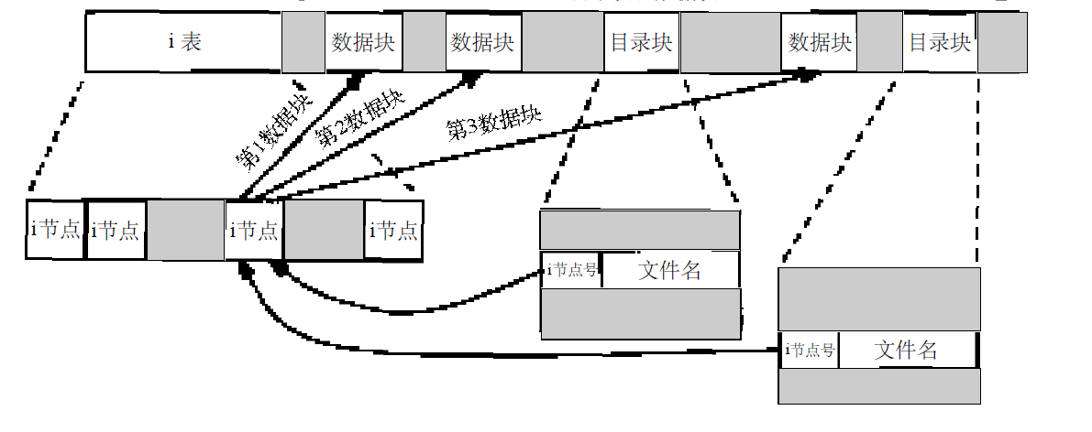
UNIX Introduction - inode

Slide 25
UNIX Introduction – Basic commands I
date - display date
+%fmt - display date in a format
see more details of date format:
man date
man strtime
diff - compare files
-r compare recursively, include subdir
Current time: Mon Jul 18 17:14:27 HKT 2011
%m | 07 | Month number
%d | 18 | Day number in the month
%H | 17 | Hour number (24 hour system)
%M | 14 | Minute number
%S | 27 | Second number
%y | 11 | Last 2 digits of the year number
%Y | 2011 | Year, including the century
%a | Mon | Locale's abbreviated weekday name
%b | Jul | Locale's abbreviated month name
%Z | HKT | time zone
[wl42485@hkdevedt6]$ date
Thu Jul 21 10:28:50 HKT 2011
[wl42485@hkdevedt6]$ date +%Y%m%d
20110721
[wl42485@hkdevedt6]$ date +%H:%M:%S
10:31:57
crypt - encode or decode a file
encrypt
crypt 123 < a.txt > b.txt
decrypt
crypt 123 < b.txt

Slide 26
UNIX Introduction – Basic commands I - find
find - find files. syntax: find dirs expressions …
-name pattern
True if file name match the pattern
-type c
True if the type of the file is c
f : plain file
d : directory
l : symbolic link
-mtime n
True if the file's data was modified n days ago.
n can be negtive, means during n days
-size n[c]
True if: file is n blocks long (512b/block); Or nc: file is in n bytes
-print
True. print current path found
-prune
True. Ignore matched file
-inum inode
find file by inode value
-ls
print detail of matched files
-newer file
True if target is newer then file
-exec cmd
execute cmd on found path
-ok cmd
like -exec, confirm each time
Precedence
() “()” are special char in shell. In cmd we need use \( \)
!, -false, -not
-and, -a “and” is the default operand.
-or, -o
Notes:
Note: for -size: if not follow "c", n is block. So files with 1 char will be found also

Slide 27
UNIX Introduction – Basic commands I - find
find *.txt
find files belongs to a user
find files newer than a file
find files that are modified within recent 5 days
[wl42485@hkdevedt6]$ find . -name '*.txt'
./b.txt
./a.txt
./empty1.txt
[wl42485@hkdevedt6]$ find /usr/bin -type f -user bin -ls
10750794 1 -rwxr-xr-x 1 bin bin 172 Oct 25 2003 /usr/bin/lp_1251
10750867 112 -r-xr-xr-x 1 bin bin 99240 Oct 25 2003 /usr/bin/solstice
10750854 152 -r-xr-xr-x 2 bin bin 147084 Sep 11 2010 /usr/bin/unzip
10750890 20 -rwxr-xr-x 1 bin bin 19832 Oct 25 2003 /usr/bin/apm
10750938 3 -r-xr-xr-x 1 bin bin 2751 Oct 25 2003 /usr/bin/mailp
10750854 152 -r-xr-xr-x 2 bin bin 147084 Sep 11 2010 /usr/bin/zipinfo
[wl42485@hkdevedt6]$ find . -type f -newer ./b.txt -ls
132406 0 -rw-r--r-- 1 wl42485 4t7 0 Jul 21 11:11 ./empty1.txt
[wl42485@hkdevedt6]$ ls -l b.txt
-rw-r--r-- 1 wl42485 4t7 6 Jul 21 10:44 b.txt
[wl42485@hkdevedt6]$ find . -type f -mtime -5 -ls
132401 1 -rw-r--r-- 1 wl42485 4t7 6 Jul 21 10:44 ./b.txt
132404 1 -rw-r--r-- 1 wl42485 4t7 6 Jul 21 10:44 ./a.txt
132406 0 -rw-r--r-- 1 wl42485 4t7 0 Jul 21 11:11 ./empty1.txt
[wl42485@hkdevedt6]$ date
Thu Jul 21 11:51:43 HKT 2011
Notes:
Note: for -size: if not follow "c", n is block. So files with 1 char will be found also

Slide 28
UNIX Introduction – Basic commands I - find
find empty files
find files is 6 bytes long
find files larger than 5 bytes long
find files less then 5 bytes
find file by inode
[wl42485@hkdevedt6]$ find . -type f -size 0 -ls
132406 0 -rw-r--r-- 1 wl42485 4t7 0 Jul 21 11:11 ./empty1.txt
[wl42485@hkdevedt6]$ find . -type f -size 6c -ls
132401 1 -rw-r--r-- 1 wl42485 4t7 6 Jul 21 10:44 ./b.txt
132404 1 -rw-r--r-- 1 wl42485 4t7 6 Jul 21 10:44 ./a.txt
[wl42485@hkdevedt6]$ find . -type f -size +5c -ls
7935149 2 -rw-r--r-- 1 wl42485 4t7 1827 Jul 5 15:11 ./.goprevious
132401 1 -rw-r--r-- 1 wl42485 4t7 6 Jul 21 10:44 ./b.txt
132404 1 -rw-r--r-- 1 wl42485 4t7 6 Jul 21 10:44 ./a.txt
[wl42485@hkdevedt6]$ find . -type f -size -5c -ls
132406 0 -rw-r--r-- 1 wl42485 4t7 0 Jul 21 11:11 ./empty1.txt
[wl42485@hkdevedt6]$ ls -i a.o
7905055 a.o*
[wl42485@hkdevedt6]$ find . -type f -inum 7905055
./a.o
Notes:
Note: for -size: if not follow "c", n is block. So files with 1 char will be found also
Can use fine -inum to delete strange file

Slide 29
UNIX Introduction – Basic commands I - find
find *.log files and delete them
Generally, we print the files first, then use -exec/-ok to delete them.
find *.log files, but except c.log
Exercise
Please delete files
~loghome/*.log
larger than 1024 bytes
no changed at least 7 days
but do not delete files in dir backup or in wl42485
[wl42485@hkdevedt6]$ find . -type f -name '*.log' -ls
132407 0 -rw-r--r-- 1 wl42485 4t7 0 Jul 21 11:54 ./a.log
[wl42485@hkdevedt6]$ find . -type f -name '*.log' -exec rm {} \;
[wl42485@hkdevedt6]$ find . -type f -name '*.log' -ls
[wl42485@hkdevedt6]$ find . -type f -name '*.log'
./a.log
./b.log
./c.log
[wl42485@hkdevedt6]$ find . -type f \( -name 'c.log' -prune \) -o -name '*.log' -print
./a.log
./b.log
Notes:
Note: for -size: if not follow "c", n is block. So files with 1 char will be found also
find ~loghome -type f -name ‘*.log’ -size +1024c -mtime +7 -print
find ~loghome -type d -name ‘backup’ -prune -o -type d -name ‘wl42485’ -prune -o -type f -name ‘*.log’ -size +1024c -mtime +7 -print
find ~loghome \( -type d -name ‘backup’ -o -type d -name ‘wl42485’ \) -prune -o -type f -name ‘*.log’ -size +1024c -mtime +7 -print
find ~loghome -type d \( -name ‘backup’ -o -name ‘wl42485’ \) -prune -o -type f -name ‘*.log’ -size +1024c -mtime +7 -print
find ~loghome -type d \( -name ‘backup’ -o -name ‘wl42485’ \) -prune -o -type f -name ‘*.log’ -size +1024c -mtime +7 -exec rm {} \;

Slide 30
UNIX Introduction – Event Designators in Shell
There may be different shell by shell. Please ref to manual for detail.
Use raadline C-r to search history cmd. It is better then !, !!
! Start a history substitution
!:1 first parameter in last cmd
!:2-3 2nd and 3rd parameters in last cmd
!* all parameters in last cmd
!! Refer to the previous command
[wl42485@hkdevedt6]$ echo a b c d e
a b c d e
[wl42485@hkdevedt6]$ !ech
echo a b c d e
a b c d e
[wl42485@hkdevedt6]$ echo !:2 !:4
echo b d
b d
[wl42485@hkdevedt6]$ echo !*
echo b d
b d
[wl42485@hkdevedt6]$ !!
echo b d
b d

Slide 31
UNIX Introduction – Special variable in Shell
$$: Process ID
$!: PID of the previous background command
$?: Return Code
$#: Number of Parameters passed in
$@, $*: All the parameters
$n – Parameters
$0 – Script name
[wl42485@hkdevedt6]$ echo $$
12268
[wl42485@hkdevedt6]$ ps
PID TTY TIME CMD
12268 pts/14 0:00 bash
[wl42485@hkdevedt6]$ vi &
[1] 13555
[wl42485@hkdevedt6]$ echo $!
13555
[1]+ Stopped vim -X
[wl42485@hkdevedt6]$ echo abc
abc
[wl42485@hkdevedt6]$ echo $?
0
# to display current shell name
[wl42485@hkdevedt6]$ echo $0
bash

Slide 32
UNIX Introduction – Job control
& run cmc in background
use ctrl-z to put current job into background
bg put background job running
+ current job
- previouse job
%jobid
run without parameter to put last job running
fg bring background job to front
jobs display jobs
-l include pid
-p only display pid
disown (bash)
job will not receive SIGHUP when shell exits

Slide 33
UNIX Introduction – Viewer and Editor - Viewer
less
can use less -N to show line number
f SPACE C-F scroll forward one screen
b ESC-v C-B scroll backward one screen
m Followed by any lowercase letter, marks the current position
‘ jump to marked position
/ search
n/N next/previous match of previouse search
F scroll forward, keep reading the file. like tail -f
q quit
v edit mode
more / page
e.g.
ma will mark current position to “a”
‘a will jump to position “a”

Slide 34
UNIX Introduction – Viewer and Editor - vi/vim
config
~/.exrc for vi
~/.vimrc for vim
set tabstop=4
set ai
2 modes of vi
insert mode
press “i”
command mode
press ESC
ex command
start by “:”
start and quit
type vi, vim to start
:q quit
open file
vi filename
:e filename
save file :w filename
move
j k h l , arraw key
move down, up, backward, forward
begin of line 0
end of line $
page down C-F
page up C-B
goto line
<line number> G e.g. 1G goto line 1
vi +100 filename
Notes:
by Billy Joy, who is the the csh designer.

Slide 35
UNIX Introduction – Viewer and Editor - vi/vim
edit
append a insert i
change c
change word cw
delete char x
delete line dd
delete word dw
parst line yy
undo u
search/replace
search /
next match n
previous match N
replace in line :s/word/new word/
replace all in line :s/word/new word/g
replace in all lines :%s/word/new word/
mark
mark m
ma mark current place as "a"
jump to mark ‘ (quote)
'a jump to mark a
jump to last mark ''
repeat edit
<prefix n> edit command
10x delete 10 chars
10dd delete 10 lines
range edit
20,30 s/word1/word2/g
replace word1 as word2 in lines 20-30
/regexp1/,/regexp2/ s/word1/word2/g
replace word1 as word2 in lines from regexp1 to regexp2
help & tutorial
:help
vimtutor
Notes:
by Billy Joy, who is the the csh designer.

Slide 36
UNIX Introduction – Viewer and Editor - emacs/xemacs
everything can have a shortcut
M Meta key, it may be ESC or ALT key, depended on your env
C Control key
S Shift key
C-x control + x
C-xf control +x, then press f
can use M-x to input command
buffer
region
config
~/.emacs ~/.xemacs/init.el
externtion
lisp language
add new package
(add-to-list 'load-path "/home/wl42485/tools/lisps/xcscope")
(require 'xcscope)

Slide 37
UNIX Introduction – Viewer and Editor - emacs/xemacs
start and quit
type emacs or xemacs to start
C-x C-c to quit
open file C-x C-f
save file C-x C-s
save as C-x C-w
move
C-a / C-e begin/end
C-f / C-b foraward/backward char
C-p / C-n previous/next line
use arrow key
C-v page down
M-v page up
M-g go to line
edit
move to the point and edit
C-d del char
M-d delete word
C-k kill line
C-y yank line
C-_ undo
search/replace
C-s forward search
C-r backward search
C-% query replace
M-x replace-string replace string
mark
C-x r SPC a save point to "a"
C-x r j a jump to point a
C-SPC begin region mark
C-u SPC jump to last mark
C-w delete region

Slide 38
UNIX Introduction – Viewer and Editor - emacs/xemacs
repeat edit
M-<n> commands
C-u <n> command
e.g. M-10 C-k kill 10 lines
range edit
select region and run command
change key bind
M-x global-set-key
change key bind globally
M-x local-set-key
change key bind in local mode
help
C-h a help apropos
C-h k help key bind
C-h i emacs info page
C-h t emacs tutorial
C-h f help function
C-h m help of current mode

Slide 39
UNIX Introduction – References
http://www.grymoire.com/Unix/
http://docstore.mik.ua/orelly/
The Art of UNIX programming

Slide 40
UNIX Introduction – The End
The End

